Slide 1
Introduction to AMBER FF
SHUG-2015
Jose M. Borreguero
Neutron Data Analysis and Visualization Division
Center for Accelerating Materials Modelling

Slide 2
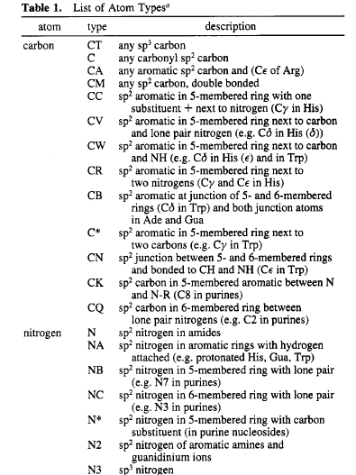
Atom types
Nuclei → Atoms with properties dependent on their chemical environment
1 element, many types !
Orb. hybridization → number of covalent bonds
polarization → fractional valence charges
charge fluctuations → Van der Waals parms.

Slide 3
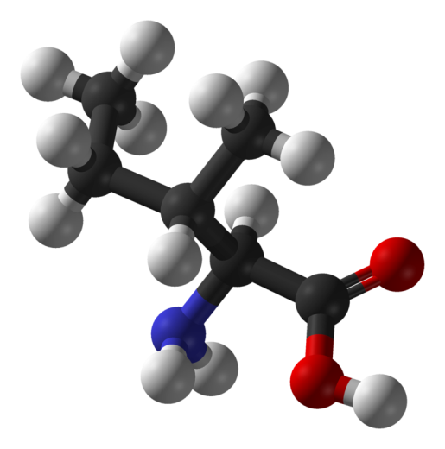
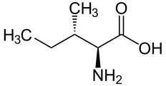
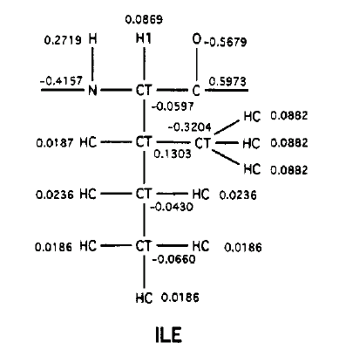
Atom types
Example: Isoleucine amino acid

Slide 4
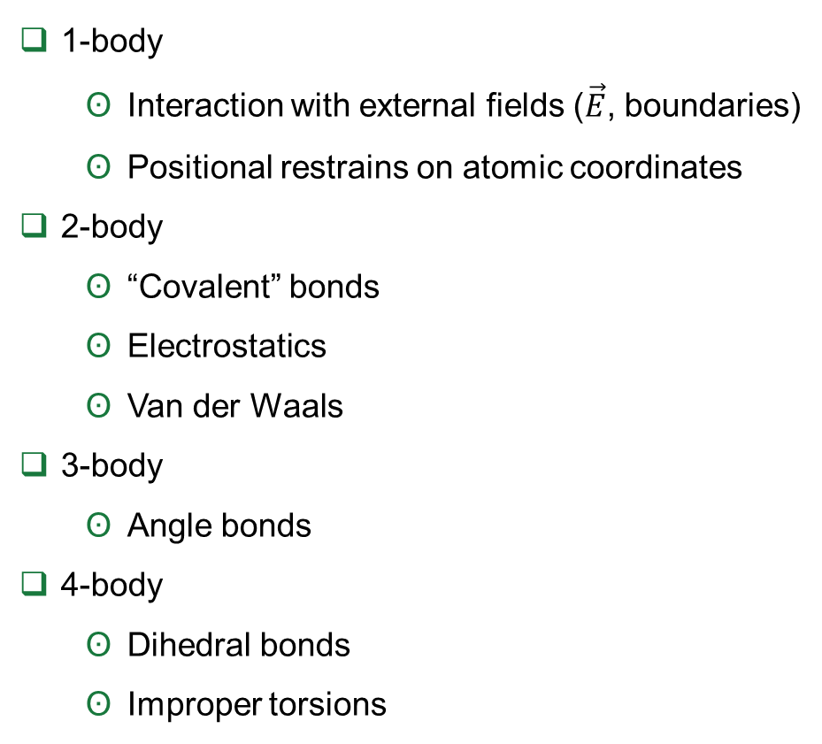
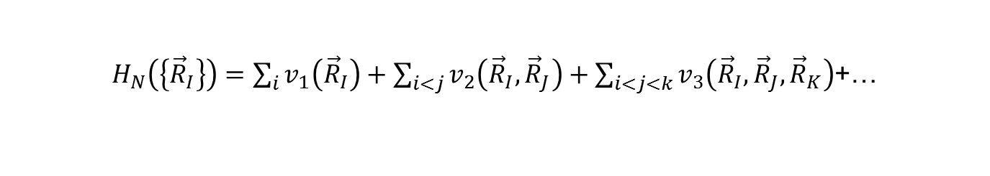
Expansion in multi-body terms
$H_{N}\left(\left\{{\vec{R}}_{I}\right\}\right)=\sum_{i}{v_{1}\left({\vec{R}}_{I}\right)}+\sum_{i<j}{v_{2}\left({\vec{R}}_{I},{\vec{R}}_{J}\right)}+\sum_{i<j<k}{v_{3}\left({\vec{R}}_{I},{\vec{R}}_{J},{\vec{R}}_{K}\right)}$+…
1-body
Interaction with external fields ($\vec{E}$, boundaries)
Positional restrains on atomic coordinates
2-body
“Covalent” bonds
Electrostatics
Van der Waals
3-body
Angle bonds
4-body
Dihedral bonds
Improper torsions

Slide 5
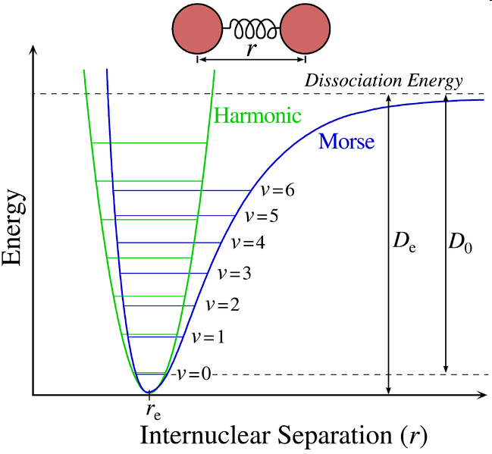
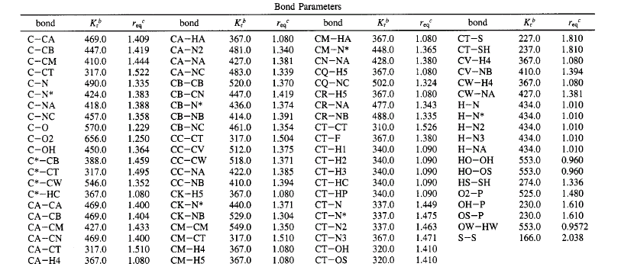
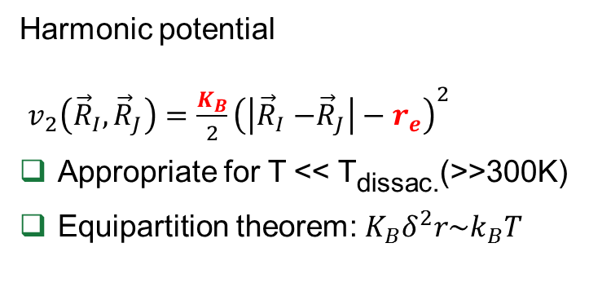
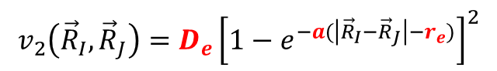
2-body: “covalent” bond
Harmonic potential
$v_{2}\left({\vec{R}}_{I},{\vec{R}}_{J}\right)=\frac{K_{B}}{2}{\left(\left|{\vec{R}}_{I}{−\vec{R}}_{J}\right|−r_{e}\right)}^{2}$
Appropriate for T << T_{dissac.}(>>300K)
Equipartition theorem: $K_{B}δ^{2}r\sim k_{B}T$
For T << T_{dissac} use the Morse potential:
$$v_{2}\left({\vec{R}}_{I},{\vec{R}}_{J}\right)=D_{e}{\left[1−e^{−a(\left|{\vec{R}}_{I}{−\vec{R}}_{J}\right|−r_{e})}\right]}^{2}$$
Example of parameterization:
(Kcal/molÅ²)

Slide 6
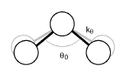
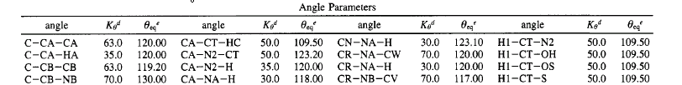

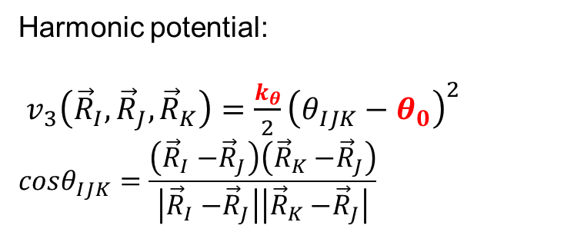
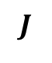
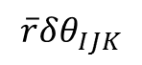
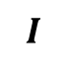
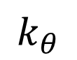
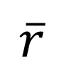
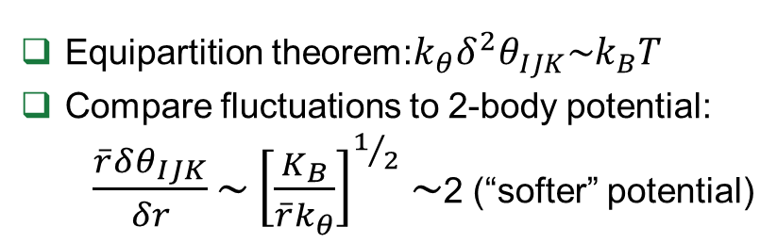
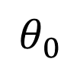
3-body: “angle bending”
Harmonic potential:
$v_{3}\left({\vec{R}}_{I},{\vec{R}}_{J},{\vec{R}}_{K}\right)=\frac{k_{θ}}{2}{\left(θ_{IJK}−θ_{0}\right)}^{2}$
$$cosθ_{IJK}=\frac{\left({\vec{R}}_{I}{−\vec{R}}_{J}\right)\left({\vec{R}}_{K}{−\vec{R}}_{J}\right)}{\left|{\vec{R}}_{I}{−\vec{R}}_{J}\right|\left|{\vec{R}}_{K}{−\vec{R}}_{J}\right|}$$
$$J$$
$$k_{θ}$$
$$\overline{r}$$
Equipartition theorem:$k_{θ}δ^{2}θ_{IJK}\sim k_{B}T$
Compare fluctuations to 2-body potential:
$\frac{\overline{r}δθ_{IJK}}{δr}\sim {\left[\frac{K_{B}}{{\overline{r}k}_{θ}}\right]}^{1/2}\sim$2 (“softer” potential)
$$I$$
$$θ_{0}$$
$$K$$
$$\overline{r}δθ_{IJK}$$
Example of parameterization:
(Kcal/mol)

Slide 7
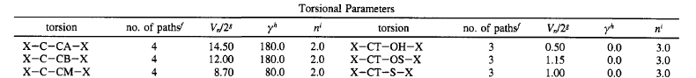
4-body: Dihedral torsion
Example of parameterization:

Slide 8
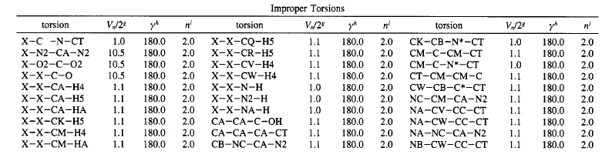
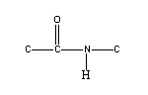
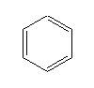
Improper torsions

Slide 9
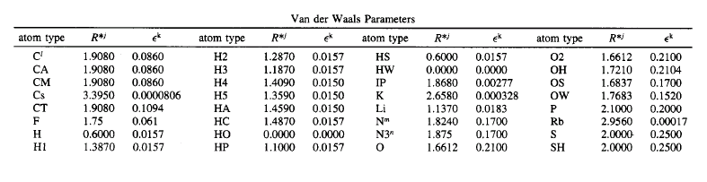
Van der Waals (LJ) parameters

Slide 10
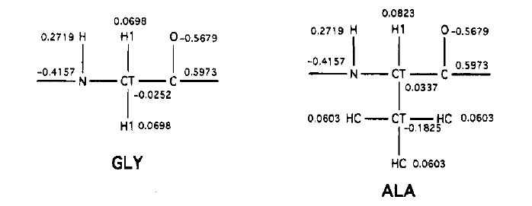
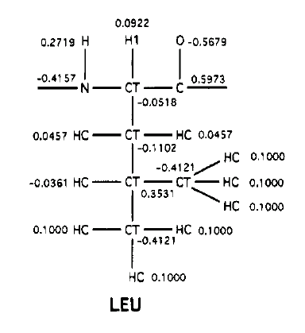
Atomic partial charges

